Slide 1
Chapter 5: The circulatory system transports materials throughout the body

Slide 2
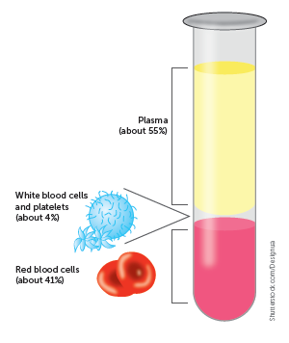
5.1 Blood as a transport medium
The structure of blood
Blood is composed of:
plasma: the liquid part
Formed elements: the non-liquid part, consisting of erythrocytes (red blood cells), leucocytes (white blood cells) and thrombocytes (platelets).

Slide 3
5.1 Blood as a transport medium
Plasma
Plasma is a mixture of water with dissolved substances such as sugar and salts. The function of plasma is to transport the components of blood, including cells, nutrients, wastes, hormones, proteins and antibodies, throughout the body.
Erythrocytes
Erythrocytes, or red blood cells, are the most abundant cells in the blood. The cells are a biconcave shape – flattened in the middle on both sides. They do not contain a nucleus, which increases their flexibility and, hence, their ability to move through blood vessels. However, the lack of a nucleus also limits their life span to only 120 days on average. The function of the erythrocytes is to transport oxygen from the lungs to the cells throughout the body.

Slide 4
5.1 Blood as a transport medium
Leucocytes
Leucocytes, or white blood cells, play an important role in protecting the body from infection. While they make up only 1% of the blood, white blood cells are larger than red blood cells.
There are a number of different leucocytes, each with its own structure and function:
Neutrophils
Monocytes
Lymphocytes
Basophils
Eosinophils.
Thrombocytes
Thrombocytes, or platelets, are small fragments of cells. When a blood vessel is injured, the platelets adhere to the lining and form a scaffold for the coagulation of the blood to form a clot.

Slide 5
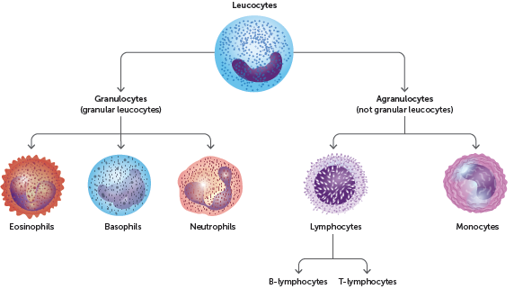
5.1 Blood as a transport medium
Types of leucocytes

Slide 6
5.1 Blood as a transport medium
Transport of oxygen
The majority of oxygen is transported on erythrocytes as oxyhaemoglobin.
Red blood cells are well suited to their function of oxygen transport because they:
contain haemoglobin, which is able to combine with oxygen
have no nucleus, so there is more room for haemoglobin molecules
are shaped like biconcave discs – the biconcave centre increases the surface area for oxygen exchange and the thicker edges give a large volume that allows room for the haemoglobin molecules.

Slide 7
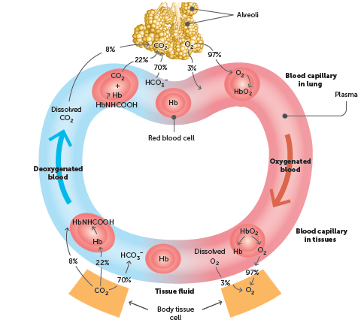
5.1 Blood as a transport medium
Transport of carbon dioxide
Carbon dioxide can be transported by dissolving in plasma (7–8%), as carbaminohaemoglobin (22%) or as bicarbonate ions (70%) in the plasma.

Slide 8
5.1 Blood as a transport medium
Transport of nutrients and waste
Nutrients and wastes (apart from carbon dioxide) are dissolved and transported in the blood plasma.
Nutrients are the essential elements and molecules that are obtained from the food we eat. Inorganic nutrients are transported as ions. Some of the important ions dissolved in the blood plasma are sodium ions (Na+), calcium ions (Ca2+), potassium ions (K+), chloride ions (Cl–) and iodide ions (I–).
Organic nutrients dissolved in the blood plasma include glucose, vitamins, amino acids, fatty acids and glycerol.
Metabolic wastes are substances produced by the cells that cannot be used and would be harmful if allowed to accumulate. The most important organic wastes that are transported in solution in the blood plasma are urea, creatinine and uric acid.

Slide 9
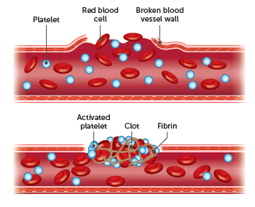
5.1 Blood as a transport medium
Blood clotting
Blood clotting helps to minimise blood loss and prevent infection after an injury that causes damage to blood vessels. It involves:
Vasoconstriction
Platelet plug
3 Coagulation

Slide 10
5.2 Moving blood through the body
The heart
The heart is the pump that pushes the blood around the body and is located between the two lungs in the mediastinum.
It is completely enclosed in a membrane called the pericardium, which holds the heart in place, but also allows the heart to move as it beats. The wall of the heart is made up of cardiac muscle.
The left and right sides of the heart are separated by a wall called the septum. The right side collects blood from the body and pumps it to the lungs, whereas the left side receives blood from the lungs and pumps it to the rest of the body.

Slide 11
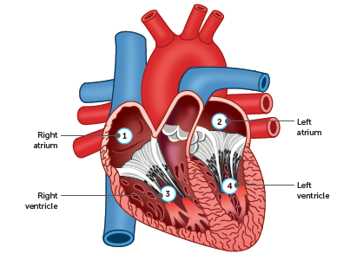
5.2 Moving blood through the body
Heart chambers
There are four chambers in the heart. The top chambers are called atria and the bottom chambers are the ventricles.
The right atrium receives blood from the body and passes it to the right ventricle.
The right ventricle pumps blood to the lungs.
The left atrium receives blood from the lungs and passes it to the left ventricle.
The left ventricle pumps blood to the body.

Slide 12
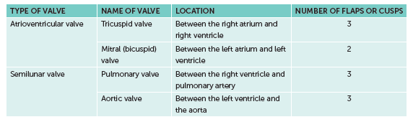
5.2 Moving blood through the body
Heart valves
Valves are located between the atria and the ventricles (atrioventricular valves), and at the exit of the ventricles (semilunar valves). They act to stop blood from flowing backwards.

Slide 13
5.2 Moving blood through the body
Blood vessels
Blood is pumped by the heart into blood vessels, which carry the blood to the cells of the body or the lungs, and then bring it back to the heart again. The same blood flows continuously through the heart, and this movement of blood is referred to as the circulation.
There are three main types of blood vessels that are joined together to form the channels through which the blood flows:
arteries
capillaries
veins.

Slide 14
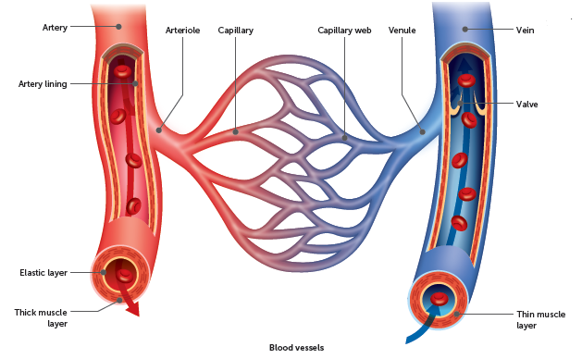
5.2 Moving blood through the body
Arteries
Arteries are the blood vessels that carry blood away from the heart. The largest artery is the aorta, which takes blood from the left ventricle to the body. Another important artery is the pulmonary artery, which takes blood from the right ventricle to the lungs. They have smooth muscle in their walls.
The very large arteries that receive blood pumped by the ventricles divide into smaller arteries, which in turn divide into very small arteries, called arterioles. Arterioles supply blood to the capillaries.

Slide 15
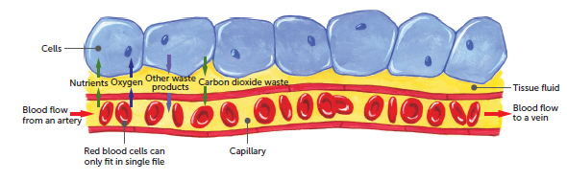
5.2 Moving blood through the body
Capillaries
Capillaries are the link between the arteries and veins. They are microscopic blood vessels that form a network to carry blood close to nearly every cell in the body. This enables the cells to get their requirements from the blood and to pass their waste into the blood.
Capillary walls have only one layer of cells, which allows substances to pass easily between the blood and the surrounding cells.

Slide 16
5.2 Moving blood through the body
Veins
Veins carry blood towards the heart. The capillaries join into small veins, venules, which then join up to make larger veins. These culminate in the:
inferior vena cava and superior vena cava, which bring blood from the body to the right atrium.
pulmonary veins, which bring blood from the lungs to the left atrium. There are four pulmonary veins – two from each lung.
Veins do not have muscular walls. Blood pressure in the veins is relatively low so many veins have valves to prevent the blood from flowing backwards.

Slide 17
5.2 Moving blood through the body
Blood flow
The requirements of cells vary depending on their level of activity, therefore the blood flow to and from the cells must be able to change. There are two ways that this can occur:
by changing the output of blood from the heart
by changing the diameter of the blood vessels supplying the tissues.

Slide 18
5.2 Moving blood through the body
Cardiac cycle
The cardiac cycle, or heartbeat, is the sequence of events that occurs in one complete beat of the heart.
The pumping phase of the cycle, when the heart muscle contracts, is called systole. The filling phase, as the heart muscle relaxes, is called diastole. For a short time both atria and ventricles are in diastole.
During this phase, the atria fill with blood and the ventricles also receive blood as the valves between them are open. Atrial systole, the contraction of the atria, then follows and forces the remaining blood into the ventricles. The atria then relax and refill while the ventricles contract in ventricular systole.
Ventricular systole forces blood into the arteries. Although the left and right sides of the heart are two pumps, they operate together. Both atria contract simultaneously, as do both ventricles.

Slide 19
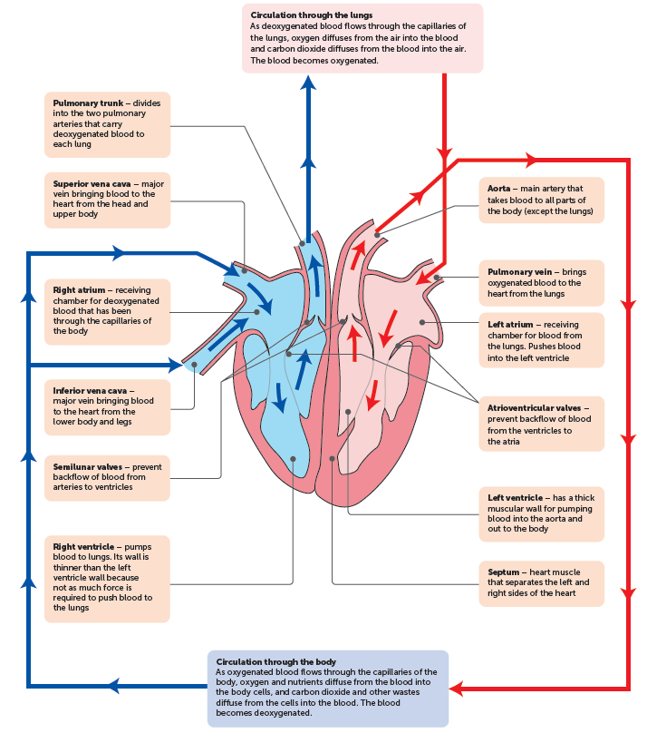
5.2 Moving blood through the body
Structure of the heart and circulation of the blood

Slide 20
5.2 Moving blood through the body
Cardiac output
How quickly the blood flows around the body depends on how fast the heart is beating and how much blood the heart pumps with each beat. The heart rate is the number of times the heart beats per minute, while the stroke volume is the volume of blood forced from a ventricle of the heart with each contraction.
A combination of both these factors influences the cardiac output – the amount of blood leaving one of the ventricles every minute. The cardiac output is equal to the stroke volume multiplied by the heart rate:
Cardiac output (mL/minute) = stroke volume (mL) × heart rate (beats/minute)

Slide 21
5.3 Blood groups and transfusions
Blood groups
The surface of red blood cells is coated with sugar and protein molecules that are able to stimulate the immune system.
These molecules are called antigens and the protein produced by the immune system is called an antibody.
The antigen and its antibody combine to form a complex and cause a reaction.
There are a number of blood group systems, but the ABO and Rh groupings are particularly important in blood transfusions.

Slide 22
5.3 Blood groups and transfusions
ABO blood groups
There are two sugar antigens involved in the ABO classification: antigen A and antigen B.
On the surface of the red blood cells a person may have either antigen A, antigen B, both antigens or neither antigen.
These four possibilities correspond to the four groups of the ABO system:
group A (antigen A), group B (antigen B), group AB (both antigens) and group O (neither antigen).
The body’s ability to make the antigens, and so a person’s ABO blood group, is determined by their DNA and is therefore inherited.
The antibody that reacts against antigen A is called anti-A, and anti-B reacts against antigen B. A person’s immune system is able to recognise their own antigens and will not produce antibodies for them, but will produce antibodies for antigens that are non-self.
A group A person can produce only the antibody anti-B, a group B person can produce only anti-A, a group AB person cannot produce either antibody, and a group O person can produce both.

Slide 23
5.3 Blood groups and transfusions
Rh blood groups
The Rhesus blood group system is also based on antigens that occur on the surface of the red blood cells. Rh antigens are proteins.
A person with Rh antigens is said to be Rh positive
a person without these antigens is Rh negative.
An individual without the Rh antigens is able to produce an anti-Rh antibody that reacts against those antigens.
Rh-positive individuals cannot produce an anti-Rh antibody.

Slide 24
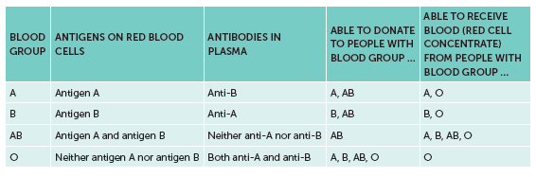
5.3 Blood groups and transfusions
Transfusions
A blood transfusion can be given to a person suffering from excessive blood loss, some types of anaemia, leukaemia, haemophilia or other conditions. It involves blood, or a blood product, from a donor being injected directly into the patient’s bloodstream.
For most transfusions it is necessary to match the ABO and Rh blood groups of the donor and the recipient.

Slide 25
5.3 Blood groups and transfusions
Types of transfusions
Different types of blood transfusions are used for different conditions. They include:
Whole blood – for severe blood loss
Red cell concentrates – for heart disease or sever anaemia
Platelet concentrates – for people with low count of platelets
Cryoprecipitate - most often used for severe bleeding
Immunoglobulins – for those who have no immunity for a particular disease
Autologous transfusion – when patient’s own blood is used

Slide 26
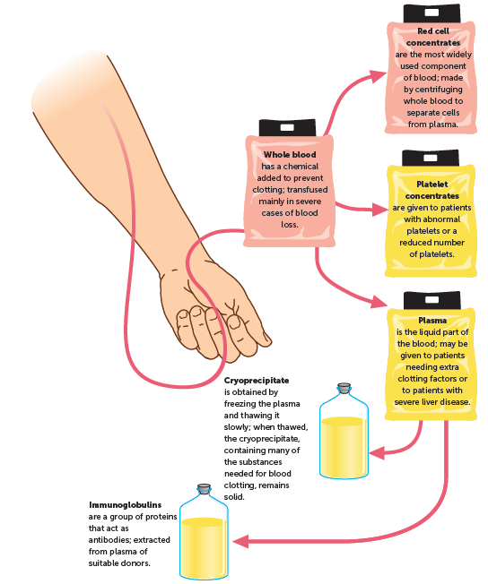
5.3 Blood groups and transfusions

Slide 27
5.4 The lymphatic system
The main function of the lymphatic system is to collect some of the fluid in the blood that escapes from the blood capillaries and return it to the circulatory system.
It is also an important part of the body’s internal defence against disease-causing organisms.
Structure
The lymphatic system consists of:
a network of lymph capillaries joined to larger lymph vessels (also called lymphatic vessels or lymphatics)
lymph nodes, which are located along the length of some lymph vessels.

Slide 28
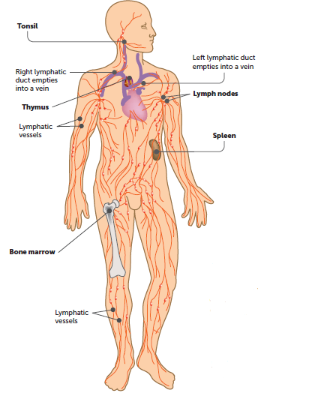
5.4 The lymphatic system

Slide 29
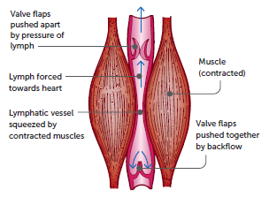
5.4 The lymphatic system
Lymph vessels
Lymph is fluid that is collected from between the cells and transported in lymph vessels to the large veins.
The lymphatic system is a one-way system carrying fluid away from the tissues. The lymph vessels originate as blind-ended tubes in the spaces between the cells of most tissues.
The network of lymph vessels joins to form two lymphatic ducts that empty the lymph into large veins in the upper chest.
Lymph is moved through the lymphatic vessels as a result of smooth muscle, skeletal muscle and valves.

Slide 30
5.4 The lymphatic system
Lymph nodes
Lymph nodes, also called lymph glands, occur at intervals along the lymphatic vessels. They are most numerous in the neck, armpits, groin and around the alimentary canal.
Nodes are bean-shaped and range in length from 1 mm to 25 mm. Each is surrounded by a capsule of connective tissue that extends into the node, forming a framework.
Within the framework are masses of lymphoid tissue, containing cells known as lymphocytes, macrophages and plasma cells. These cells help protect the body against disease.
Lymph enters through vessels on the convex side of the node, filters through the spaces and passes out through vessels on the opposite side. The lymph passes through several nodes before entering the circulatory system.

